Slide 1
VIDEO SUMMARIZATION USING HISTOGRAM ANALYSIS
VIDYVARDHINI’S COLLEGE OF ENGINEERING AND TECHNOLOGY
CLASS- BE COMPS
INSTRUCTOR: Prof. Smita Jawale
TEAM MEMBERS:
Yash Patange
Prashant Porwal
Akhil Raut

Slide 2
INTRODUCTION
Everyone is so busy with their lives that taking the time out for some activities is highly difficult.
Not everyone can watch an entire livestream of an important event occuring in history.
The proposed system aim to condense the entire full length video into a ‘highlight stream’ using Histogram Analysis.

Slide 3
PURPOSE OF OUR PROJECT
Our project, Video Summarization cuts and summarizes an entire video into a small video clip of relevant information.
It allows all those people who couldn’t get time to watch the stream, watch the highlight stream and still enjoy it.

Slide 4
Problem Definition
The main aim of Video summarization is to provide clear analysis of video by removing duplications and extracting key frames from the video. Massive growth in video content poses problem of information overload and management of content.
In order to manage the growing videos on the web and also to extract an efficient and valid information from the videos, more attention has to be paid towards video and image processing technologies.
Video summarization is a mechanism to produce a short summary of a video to give to the user a synthetic and useful visual abstract of video sequence; it can either be an image (key frames) or moving images.
Video summarization is a vital process that facilitates well-organized storage, quick browsing, and retrieval of large collection of video data without losing important aspects. In terms of browsing and navigation, a good video abstract will enable the user to get maximum information about the target video sequence in a specified time limitation or adequate information in the minimum time.

Slide 5
Future Scope
This can be used in video hosting websites to show us what the video is about in its thumbnail.
GoPro video logging.
Event Detection can be applied and be used in surveillance videos.
Can be used to skim through large video repositories.
Movie Trailers.

Slide 6
EXISTING ALGORITHM
Key-frame extraction:
Simple method is to select first frame of each shot segment as key-frame.
The rest of the frames are not inspected to determine whether they are also represented by the selected key-frame.

Slide 7
Singular value decomposition method calculates color histogram of video frames in RGB color space. To incorporate spatial information each frame is divided into 3*3 blocks and a 3D histogram is created for each block. The nine histograms are then concatenated together to form a feature vector. These feature vectors are used to form clusters and for each the frame closest to the cluster center is selected as a key-frame.

Slide 8
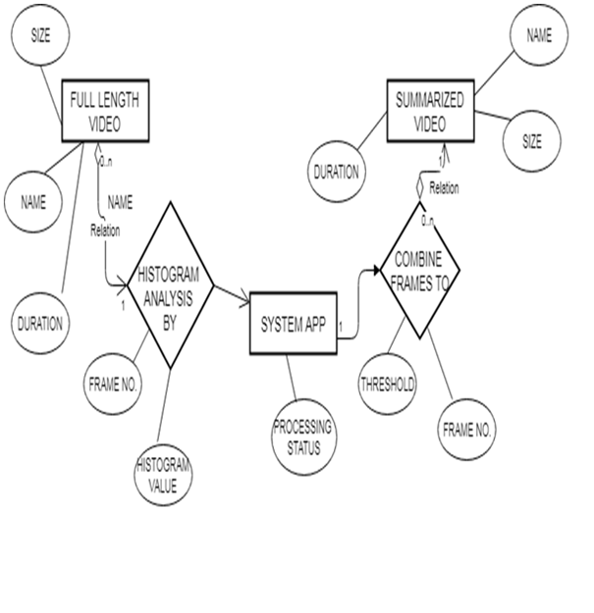
ENTITY RELATIONSHIP DIAGRAM:

Slide 9
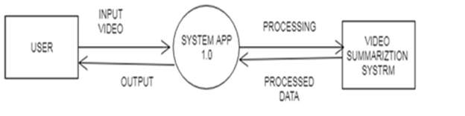
DATA FLOW DIAGRAM:
Level 0 :

Slide 10
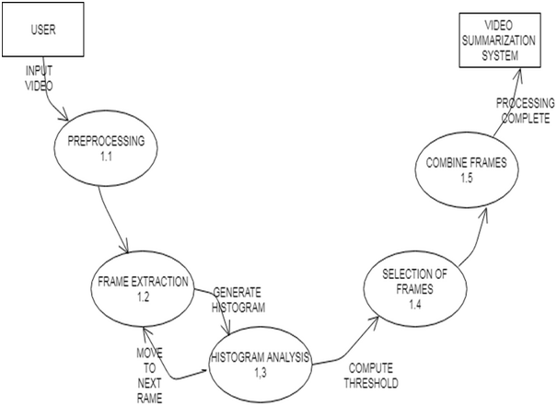
Level 1:

Slide 11
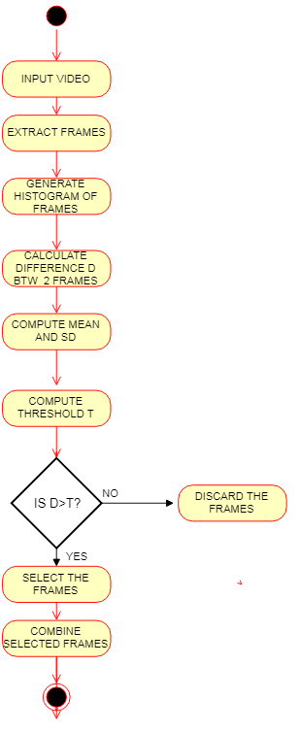
ACTIVITY DIAGRAM:

Slide 12
TECHNOLOGY
Language : Python (Version-2.7)
Librabries : Tkinter, OpenCV
O.S. - Windows 10

Slide 13
Clustering
Clustering is a Machine Learning technique that involves the grouping of data points.
Given a set of data points, we can use a clustering algorithm to classify each data point into a specific group.
In theory, data points that are in the same group should have similar properties and/or features, while data points in different groups should have highly dissimilar properties and/or features.
Clustering is a method of unsupervised learning and is a common technique for statistical data analysis used in many fields.

Slide 14
K-Means Clustering
K-Means is probably the most well know clustering algorithm.
Steps :-
Initialize cluster centers
Assign observations to the closest cluster center
Revise cluster centers as mean of assigned observations
Repeat step 2 and step 3 until convergence

Slide 16
STEPS FOR IMPLEMENTATION
1.Extract frames one by one
2.Histogram difference between 2 consecutive frames.
2.Histogram difference between 2 consecutive frames.
4. Form buckets corresponding to the n^{th} second in the video.

Slide 17
5.Pick the buckets that are filled the highest.
6.Merge the selected buckets into a summary.

Slide 18
Algorithm
Inputs: Video V to be summarized.
Capture the video V.
Generate frames fi for the video.
Calculate the Histogram for each frame.
Calculate the histogram difference between i^{th} and (i+25)^{th} frame.
Form 3 clusters of these difference values using K-Means Clustering Algorithm.
Select clusters 1 and 3, as these contain the key-frames of our video.
Form buckets of time t seconds and sort the frames from clusters 1 and 3 corresponding to the seconds they belong to in the video.
The buckets with the maximum number of corresponding frames, above a certain threshold, are selected.
The t second clips are extracted from the original video and merged together.
After merging summarized video is the output.

Slide 19
CONCLUSION
This software could be used for the formation of highlight reels.
It will showcase the important events occurring in the video.
This can be used by various show-casters, news channels or even by video loggers.

Slide 20
REFERENCE
1. Nada Jasim Habeeb, Rana Saad Mohammed, Muntaha Khudair Abbass, "Surveillance Video Summarization Based on Histogram Differencing and Sum Conditional Variance", International Journal of Computer and Information Engineering Vol:10, No:9, 2016.
2. Gao, Yue and Qiong-Hai Dai, "Shot-based similarity measure for content-based video summarization." In Image Processing, 2008, ICIP 2008. 15th IEEE International Conference on, pp 2512-2515. IEEE, 2008.

Slide 21
3. https://opencv-python-tutroals.readthedocs.io/
en/latest/py_tutorials/py_setup/py_intro/py_intro.html
4. https://stackoverflow.com/
5. https://docs.scipy.org/doc/numpy/

Slide 22
THANK YOU.

